Slide 1
Introduction to
Project Scheduling
Managing Project Schedules

Slide 2

Project Management Process
“Align the Team”
+ 10% of
Project effort
“Plan the Work”
“Endorse the Plan”
+ 90% of
Project effort
“Work the Plan”
Notes:
Managing Project Delivery
“plan the work” (Developing the schedule and budget using and IDT approach)
“endorse the plan” (Getting buy-in and commitment from project team)
This is only +/-10 % of project effort…
“Work the Plan” (active management of schedule and budget)
This takes +/-90% of project effort.

Slide 3
Project Management Process
Initiate
& Align
Plan
the Work
Endorse
the Plan
Project Team Commitment
Management Endorsement
Project Description
Team Mission/ Assignment
Major Milestones
Boundaries
Team Identification
Roles & Responsibilities
Measures of Success
Operating Guidelines
Work Breakdown Structure (WBS) / Master Deliverables List (MDL)
Task Planning & Scheduling
Budget
Risk Planning
Communication Plan
Change Management Plan
Quality (QA/QC) Plan
Transition & Closure Plan
Work
the Plan
Transition
& Closure
Managing Scope, Schedule & Budget
Manage Risks
Manage Change
Communicate
  Progress
  Issues
  Lessons Learned
Implement Transition Plan
Review Lessons Learned
Reward & Recognize
Archive
Continuous Communication

Slide 4
Project Management Process
Initiate
& Align
Plan
the Work
Endorse
the Plan
Manage the Scope, Schedule, & Budget
Manage Risks
Manage Change
Communicate:
  Progress
  Issues
  Lessons Learned
Work
the Plan
Transition
& Closure

Slide 5
Active
Project Management
Regular comparison of
“Planned”
(activities, accomplishments, costs, etc)
with
“Actuals”
(activities, accomplishments, costs, etc)
Notes:
Active Management of the Project Schedule & Budget
Regular comparison of
“Planned”
(activities, accomplishments, costs, etc.)
With
“Actuals”
(activities, accomplishments, costs, etc.)
(highlight Active in title)
(highlight Schedule & Budget in title)

Slide 6
Active
Project Management
Feedback loop of control
Baseline
Endorsement
Updated Baseline
Scope
Schedule
Budget
New/Updated Plan
Track Actual Performance
Forecast to
complete
(aging, etc.)
Variance
NO
YES
Correction
Action
Record Actual
Performance

Slide 7
Active
Project Management
Items to track in PDIS
SCHEDULE TRACKING
Actual Start: The actual date a task was started on.
% Complete: Elapsed Duration/Total Duration
Base Cost % Complete: % of deliverable completed.
Actual Finish: The actual date a task was completed

Slide 8
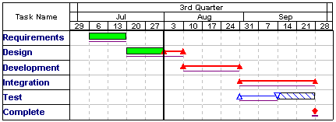
Active
Project Management
Controlling the Schedule
Schedule data should be current up to the date line

Slide 9
Active
Project Management
“Schedule “Integrity”
A project schedule that is not kept current is likely more “dangerous” than having no schedule at all. A non-current schedule can easily deceive you into thinking the project is at a certain point of evolution when in reality it is not.

Slide 10
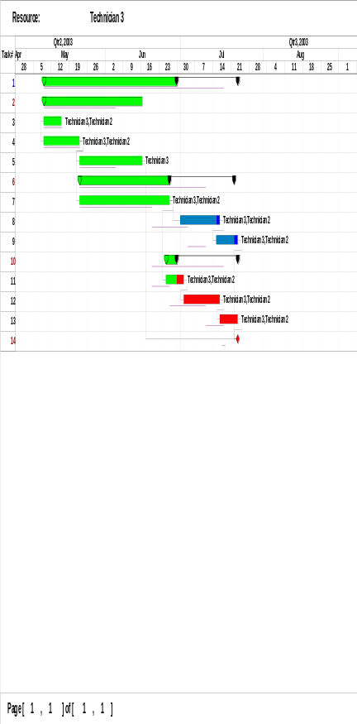
Introduction to
Project Scheduling
Task Planning
Schedule
Work Breakdown Structure
Team Mission
Statement
Network Diagram
Notes:
{NO ANIMATION}
Introduction to Project Scheduling
(Graphics of WBS, Task Planning, Pert Chart, Gantt Chart)
An assumption is made that the participants in the class have an understanding of the “Managing Project Delivery” (MPD) process and have taken the MPD class.
MPD class takes you to the WBS process. This class develops the schedule from this point on.

